Slide 1

Introduction To Workshop Technology
Department: B.Tech CSE (Data Science)
Efforts By:- Aman Kushwaha

Slide 2
Acknowledgement
I have taken efforts in this project. However, it would not have been possible without the kind support and help of many individuals.
I am highly indebted to my Workshop Technology teacher, Dr. Ravin Sehrawat, for his invaluable guidance which has sustained my efforts in all the stages of this project work.
My thanks and appreciation also go to my fellow classmates and the laboratory assistant in developing the project and to the people who have willingly helped me out with their abilities.

Slide 3
Index
Introduction
Production
Job Production
Batch Production
Mass Production
Manufacturing Processes
Classification Of Manufacturing Process
Primary Shaping Processes
Machining Processes
Joining Processes
Surface Finishing Processes
Processes Effecting Change In Properties

Slide 4
Introduction
Workshop technology is compose of various manufacturing processes or trades, such as fitting, smithing, forging, and machining, etc. It plays a crucial role for engineers, supervisors, and workers in understanding both the practical and theoretical aspects of their work. This knowledge is now considered essential, ensuring that individuals involved in manufacturing have a fundamental grasp of processes and materials, enabling skillful and informed work in the workshop.

Slide 5



Production
Production refers to the process of creating goods or services through various activities, including manufacturing, assembly, or service delivery, to meet the demands and needs of consumers or clients. It involves transforming inputs like raw materials, labor, and technology into finished products or services for distribution and consumption.
Generally there are three type of production:
Job Production
Batch Production
Mass Production

Slide 6
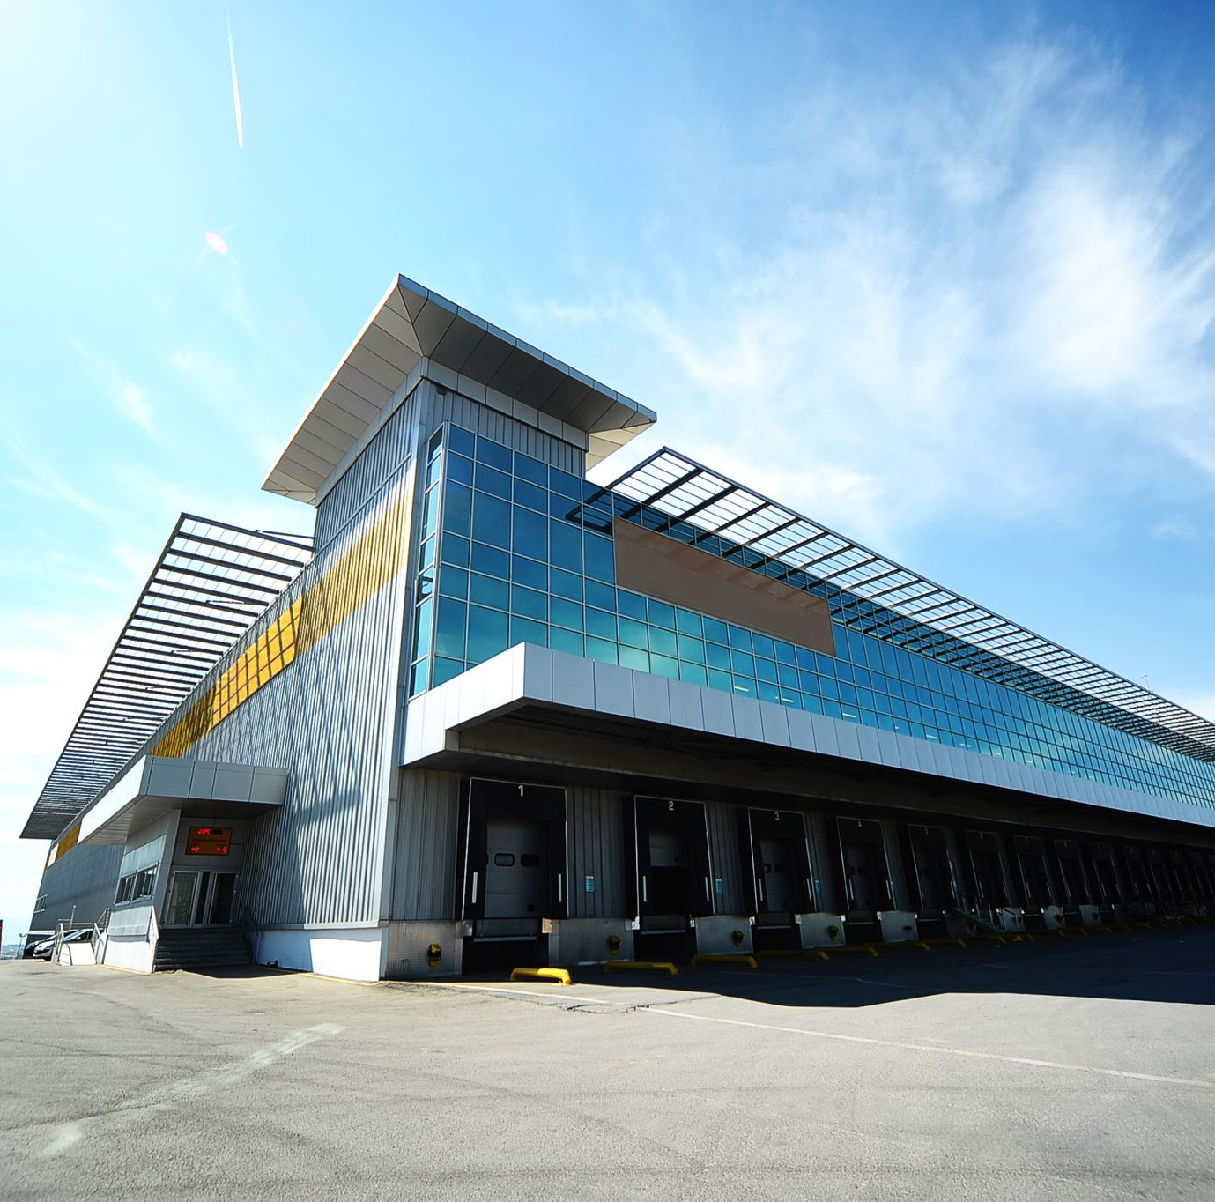
Job Production
Job production involves operators working on one job at a time, completing it before moving on to the next, whether it's a unique project, prototype, or specialized machinery like large generators, engines, or shipbuilding. This approach is suited for specialized and specific tasks, emphasizing individualized production for items such as special machinery and complex projects.
Types of Job Production:
A small number of pieces produced only once.
A small number of pieces produced intermittently when the need arises.
A small number of pieces produced periodically at known time intervals.

Slide 7
Batch Production
Batch production is a manufacturing method where multiple identical items are produced to meet customer demand. It involves producing a specific quantity of items before switching to another product. This approach optimizes efficiency by utilizing available machines for various items in sequential batches.
Types of Batch Production:-
Batch produced once.
Batch produced repeatedly at irregular intervals.
Batch produced periodically at regular intervals.

Slide 8
Mass Production
Mass production involves the efficient manufacturing of numerous identical items. It relies on auxiliary tools, fixtures, and automated systems to minimize production time and costs. Specialized equipment, such as inspection devices and material handling systems, further streamline the process, ensuring consistency and high output in the production of goods.
Types of mass production:-
Flow Production

Slide 9
Manufacturing Processes
Manufacturing processes involve transforming raw materials into finished products. In industry, metals often start as ingots, raw castings. These ingots undergo various processes to become usable items.

Slide 10
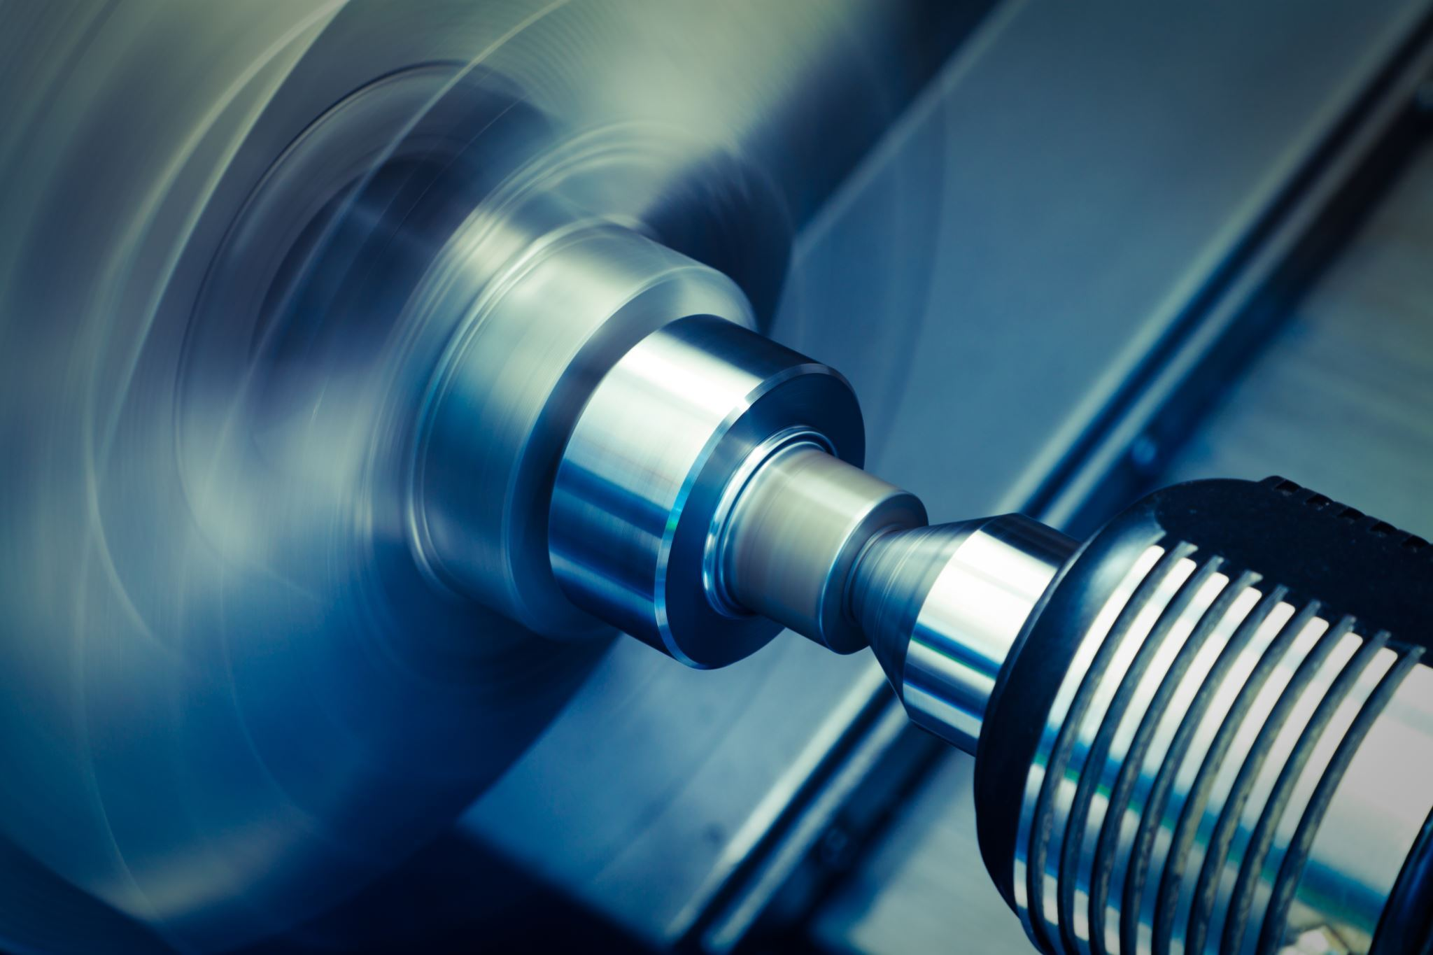
Primary Shaping Processes
Ingots purchased from the market often require re-melting in a cupola or foundry furnace. The molten metal is then poured into molds to create castings. Alternatively, ingots can be transformed into usable forms through processes like forging or primary shaping.
Shaping process include:-
Casting:- Casting is the creation of objects by pouring molten metal into molds, including die-casting, to achieve desired shapes and sizes.
Forging:- Forging is a metal shaping process involving plastic deformation at high temperatures through steady blows or pressure to achieve desired shapes.
Smithy:- Smithing is manual labor involving heating raw materials in an apex furnace to craft small objects through material conversion.
Etc....

Slide 11
Machining Processes
Machine tools, including lathes, mills, and grinders, perform machining operations to create intricate shapes and profiles for diverse applications.
Machining Operations:-
Shaping:- Shaping uses a shaper to create flat surfaces in various planes (horizontal, vertical, or angular) through a machining process.
Turning:- Turning is the process of reducing the diameter of the cylindrical workpieces by using lathe machine tool.
Drilling:- Process to produce holes.
Etc...

Slide 12

Joining Processes
Joining processes unite metal parts, enabling temporary or permanent connections, serving crucial roles in manufacturing and construction applications.
Temporary Joining Processes:
Nuts and Bolts
Screwing
Etc...
Permanent Joining Processes:
Welding
Soldering
Etc...

Slide 13

Surface Finishing Processes
These processes improve metal surface finish by either minimal material removal or adding a small amount to the product's surface for enhanced quality.
Surface Finishing Process:-
Polishing
Buffing
Etc...

Slide 14
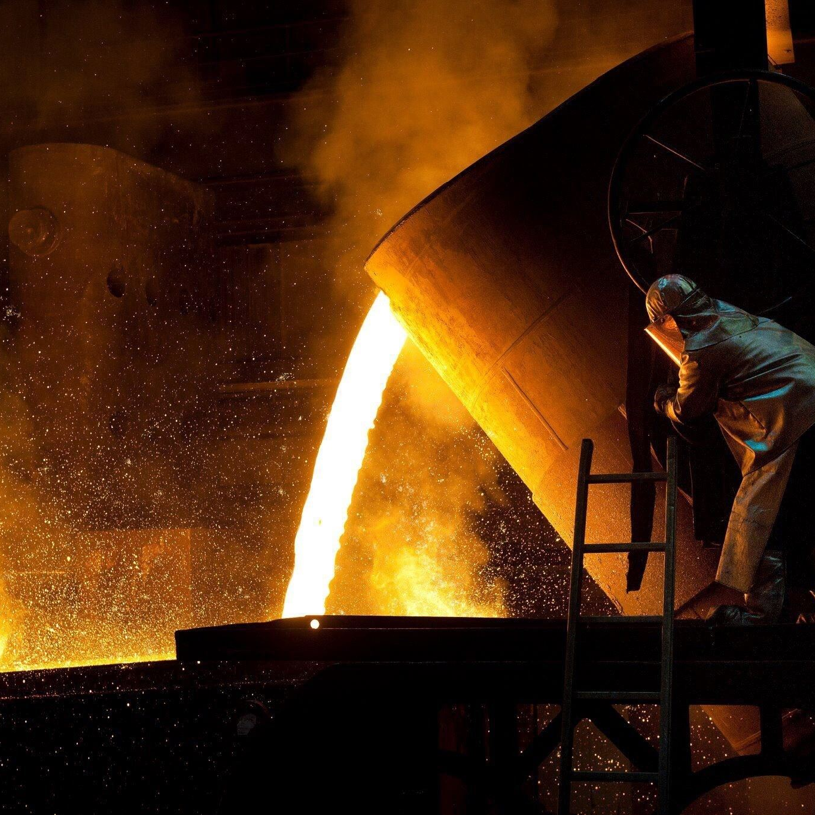
Processes Effecting Change In Properties
These processes are used to impart certain specific properties to the metal part for specific conditions of use
Processes:-
Annealing: Process of Heating steel 50-60°C above upper critical temp, hold, then slow cool in furnace for desired properties.
Hearding: Steel is heated above its critical point, held, then rapidly cooled in water, oil, or molten salts for hardening.
Etc...

Slide 15
Conclusion
In conclusion, workshop technology is a fundamental aspect of modern industrial processes, encompassing various tools, techniques, and skills. It plays a pivotal role in manufacturing, construction, and repair work, enabling the creation of intricate and precise products. A well-equipped workshop, along with skilled technicians, is essential for innovation and productivity across industries. Continual advancements in technology and the integration of digital tools are shaping the future of workshop practices, making them more efficient, sustainable, and adaptable to changing demands. Embracing these changes and investing in the development of skilled technicians will be crucial for success in the ever-evolving landscape of workshop technology.

Slide 16




Bibliography
Workshop Technology Vol.1 (Manufacturing Processes) by B.S. Raghuwanshi
Workshop Technology by S.K. Garg

